Slide 1

High Impact Skills Development Program for Gilgit Baltistan D S - A I
Capstone Project
Title: Fruit Quality Inspection System
Group Members:
Jahangeer Ali Gil-23071
Ahtasham Hussain Gil-23305
Nisar Ahmed

Slide 2


Outline
Introduction
Problem Statement
Dataset Description
Proposed Methodology
Model Selection and Training
Results
Conclusion

Slide 3
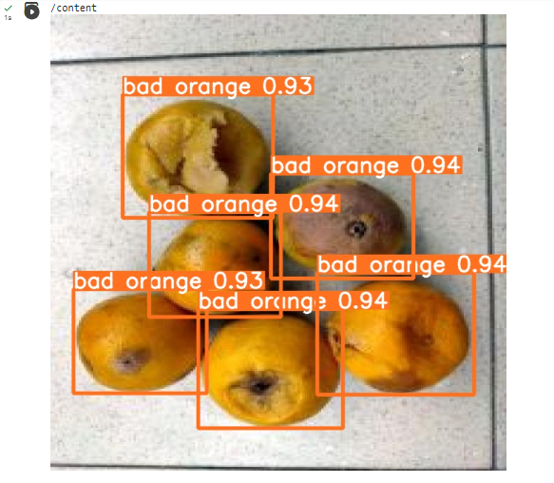
Introduction
Fruit quality inspection System is an object detection-based project, that use Yolo algorithms to evaluate the quality of fruits.
The process involves capturing images of fruits using cameras, analyzing the images to identify defects, and grading the fruits based on the physical characteristics.
This method can accurately and efficiently assess fruit quality, enabling producers to make informed decisions on harvesting, storage, and distribution.

Slide 4
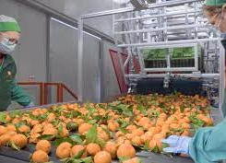
Problem Statement
The fruit industry faces several challenges in ensuring the quality and safety of their products.
One of the significant challenges is the time and labor-intensive process of manual fruit quality inspection.
Traditional methods rely on human inspectors to evaluate the quality of fruits based on subjective criteria, which can lead to inconsistencies and errors in grading.

Slide 5
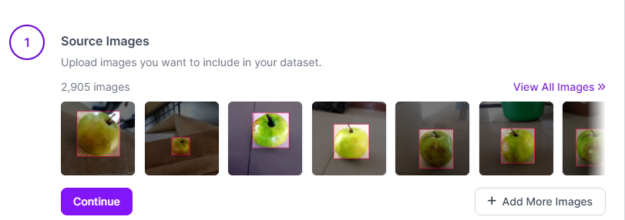
Dataset Description
The process involves capturing images of fruits using Mobile Phone and Download form Internet (Kaggle fruits Dataset).
annotation
Preprocessing

Slide 6
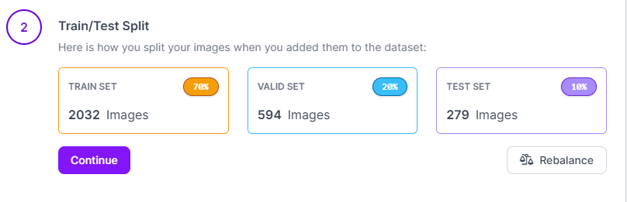
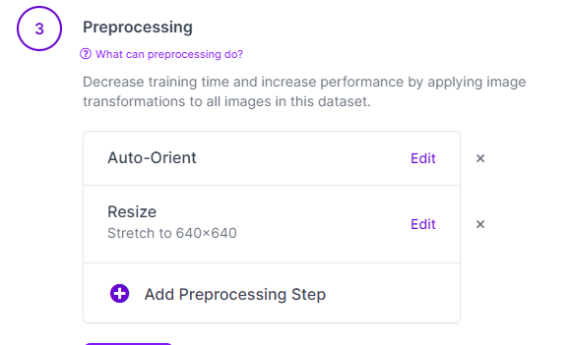
Dataset Description
Total images : 2905
Training images : 70%
validation images : 20%
Test images : 10%

Slide 7
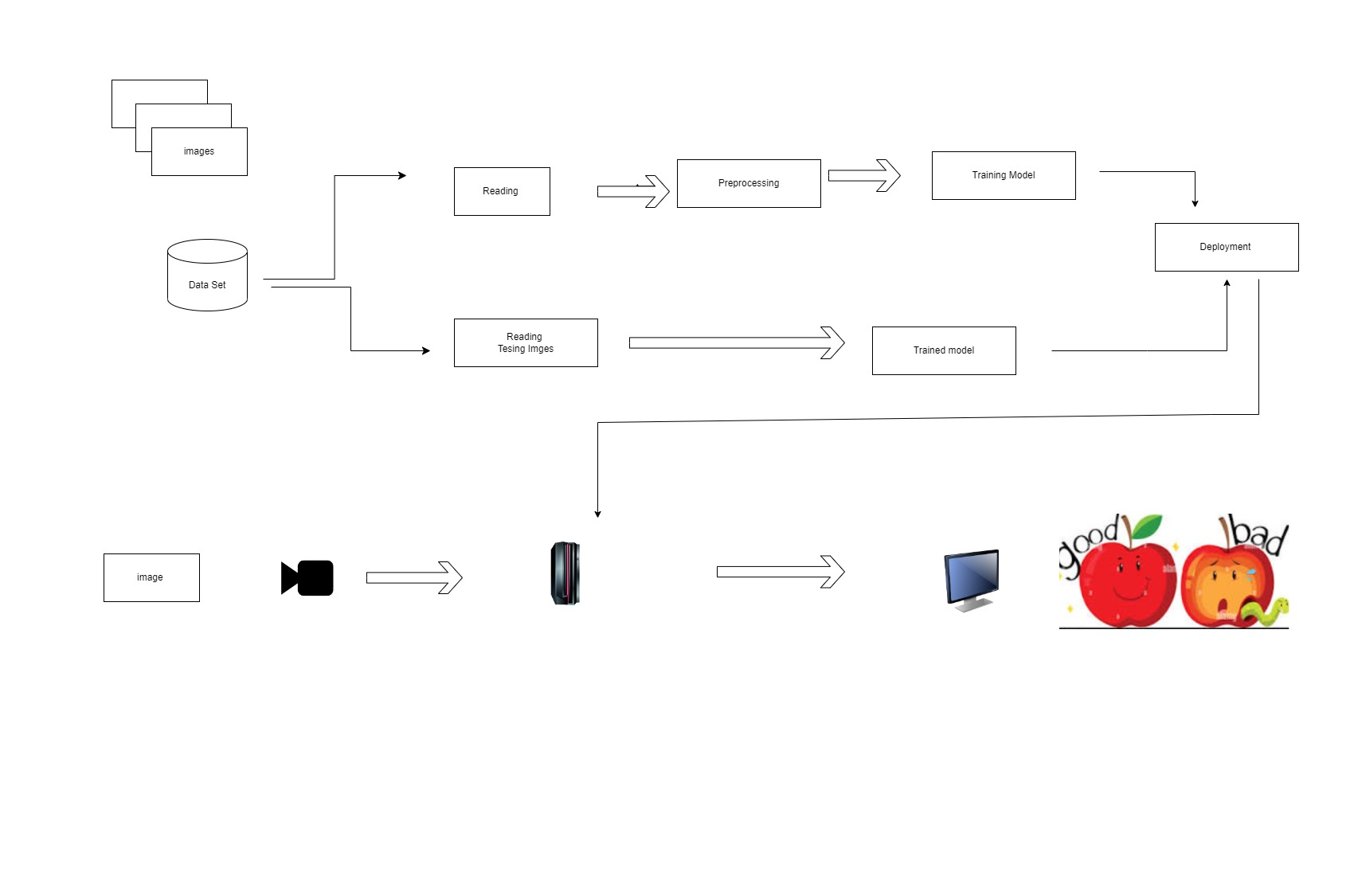
Proposed Methodology

Slide 8

Model
YOLO (You Only Look Once)
Yolo8v8s
Fast and accurate
detects multiple objects in a single frame
It is a single-stage detector

Slide 9
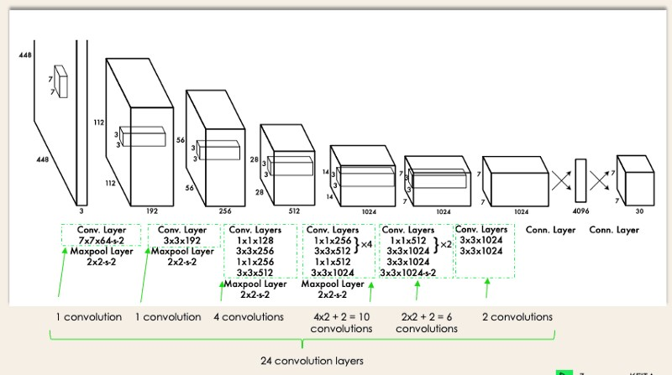
Model

Slide 10
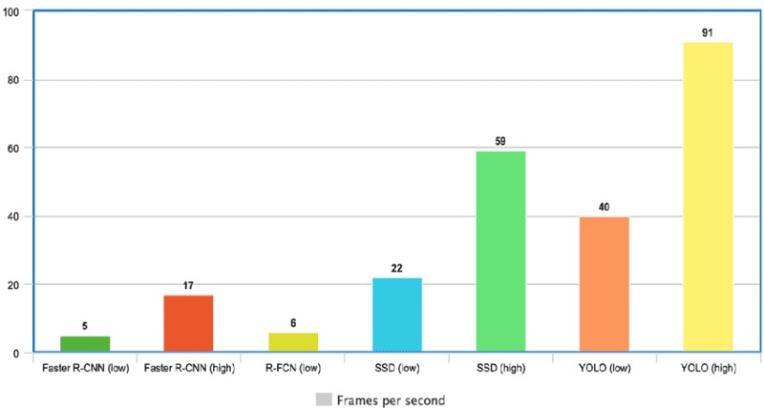
Model

Slide 11
Training

Slide 12
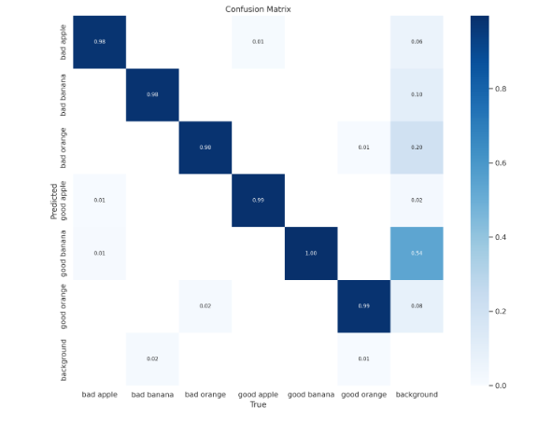
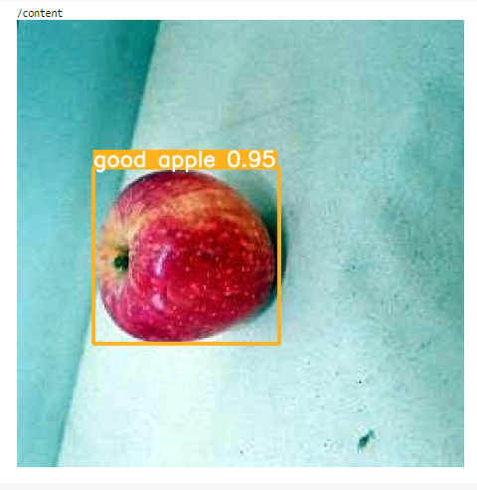
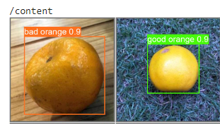
Results

Slide 13
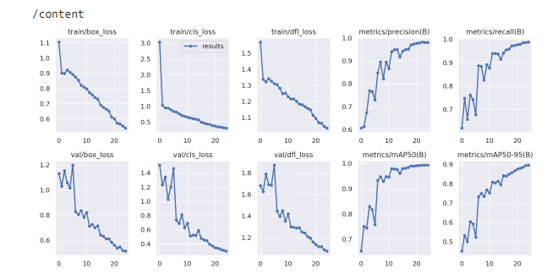
Results

Slide 14
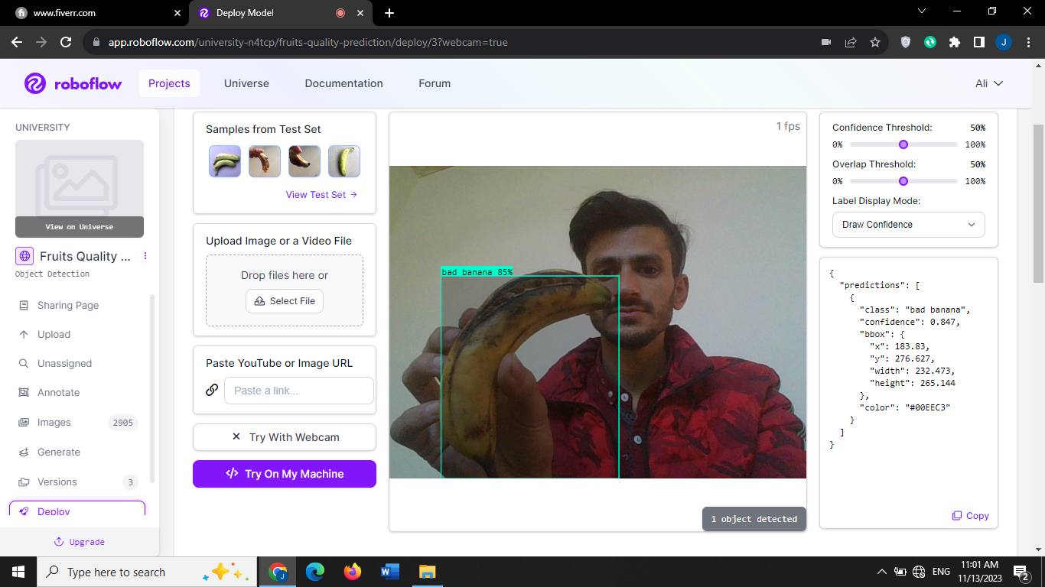
Results

Slide 15
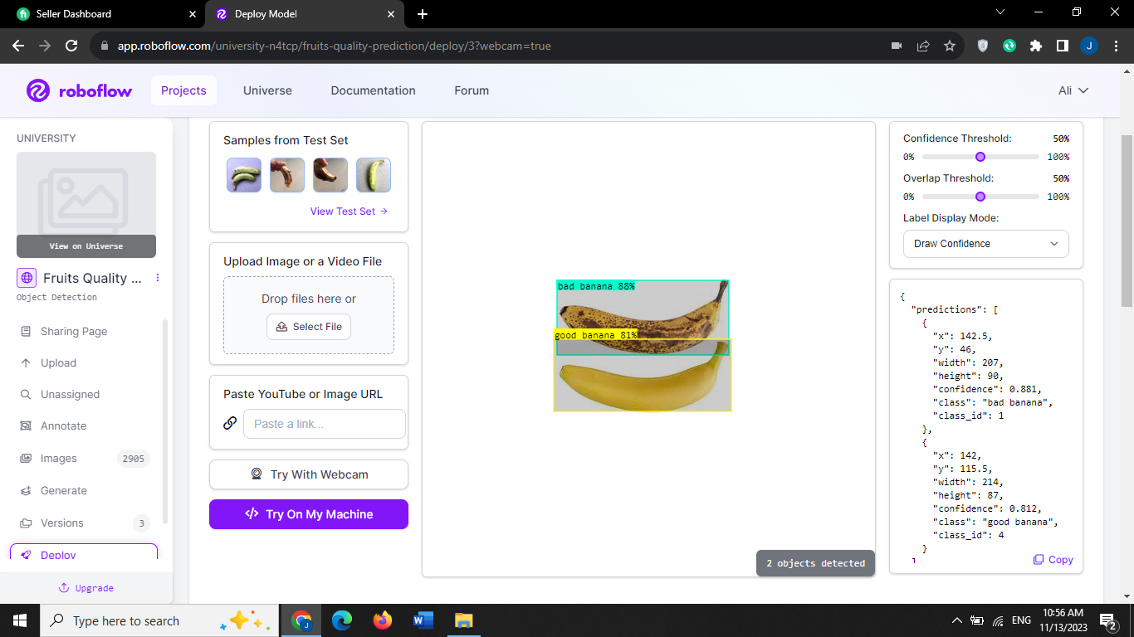
Results

Slide 16
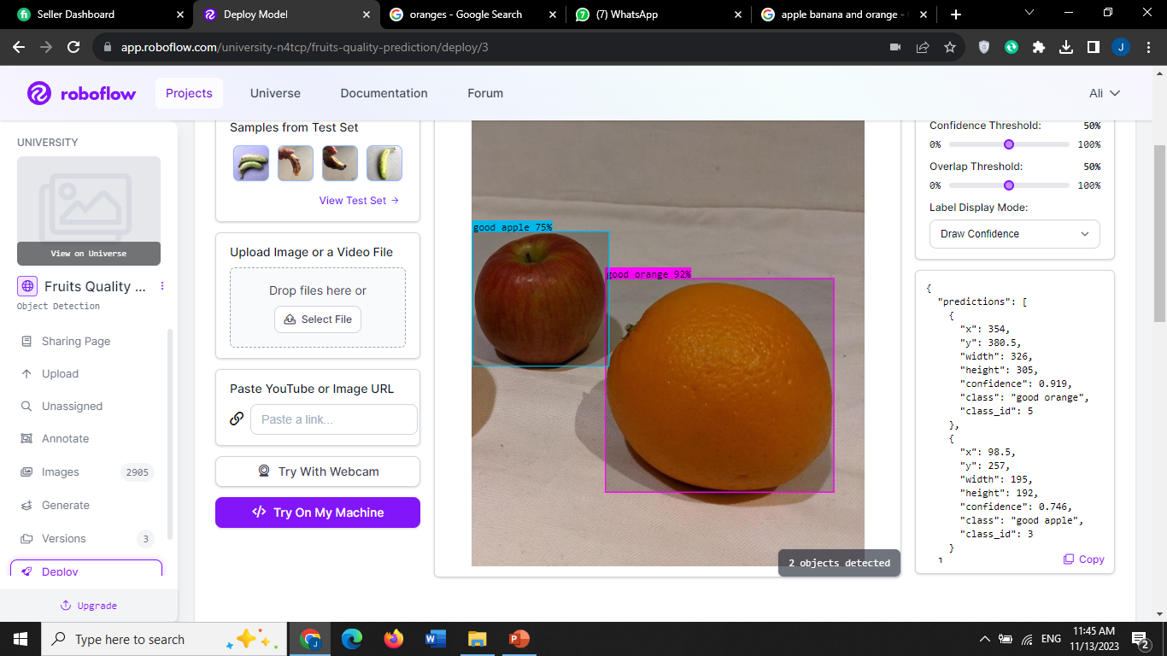
Results

Slide 17
Conclusion
Fruit quality inspection systems offer a promising solution to the challenges faced by the fruit industry, agriculture and fruit stores and providing a fast, reliable, and accurate method for fruit quality inspection that can benefit growers, distributors, and consumers alike. Vision-based fruit quality inspection systems offer a promising solution in ensuring the quality and safety of their products. These systems use cameras and image processing techniques to provide fast, accurate, and objective assessments of fruit quality, reducing the time and labor-intensive process of manual inspection.

Slide 18

Tools & Technologies
Development
YOLO
Python
Tools
Colab
Vs Code
Roboflow

Slide 19
Thanks! Do you have any Questions?

